Slide 1
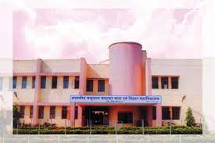
GOVT CHANDULAL CHANDRAKAR PG COLLEGE PATAN
SUBMITTED BY SUPERVISED BY
ATUL KUMAR THAKUR MISS.. NIDHI SINGH THAKUR
P.G.D.C.A ASSITANT PROFESSOR
TYPES OF SOFTWARE & FREE DOMEN SOFTWARE

Slide 2
Index
S. NO | TOPIC CONTAIN | SLIDE . NO
1.. | What is Software | 3
2.. | Types of Software | 4
3.. | System Software | 5
4.. | Operating System | 6
5.. | Application Software | 7-9
6.. | Customized Package | 10
7.. | Free Domen Software | 11

Slide 3
Software
"A set of instructions given to the computer to solve a problem is called Software."
"Software is a single/collection of programs that performs a particular task."
Software is also called Group of Program.

Slide 4
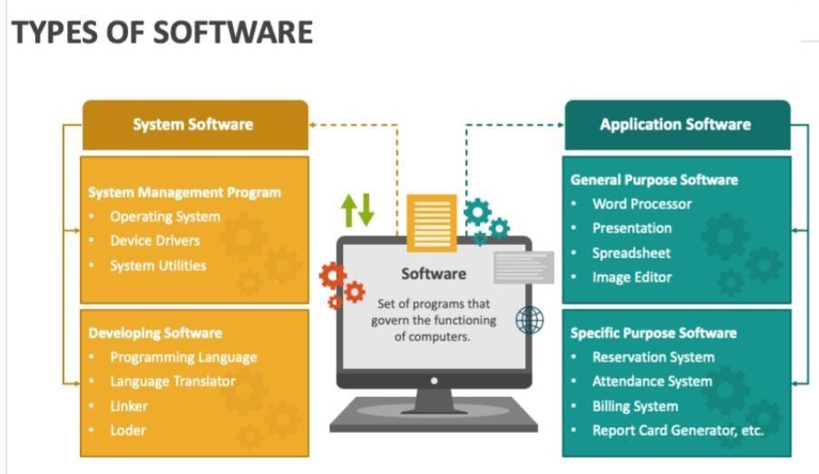
Types of Softwre
Software can be classified mainly two category….
System Software
Application Software

Slide 5
RELATIONSHIP BETWEEN HARDWARE SYSTEM SOFTWARE AND APPLICATION SOFTWARE
SYSTEM SOFTWARE
Its includes operating system and various utility software.
System Software is set of Program to control and manage the operation of a computer hardware.
USES - For Communication to various hardware Device
like..Comand to Monitor ,CPU , Printer .etc
HARDWARE
SYSTEM SOFTWARE
APPLICATION SOFTWARER

Slide 6

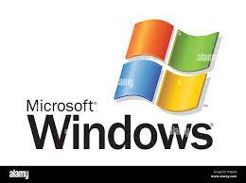

Few examples of system software are:
Operating system
Programming language & translators
Communication software
Compiler and Interpreters
Command line sheil
OPERATING SYSTEM (OS)-
OS and utility software is application software category.
OS that provides an interface for a user to communicate with the computer, manages hardware devices (disk drives, keyboard, monitor, etc), . Some popular Operating systems are UNIX, Windows and Linux.

Slide 7
Utility software -
Utility Software is Group of various program, they work for maintenance & routine..
Few examples of utility software are:--
Anti-virus
Registry cleaners
Disk defragmenters
Data backup utility
Disk cleaners
Application Software -
Application software is a set of programs, which are written to perform specific tasks,
for example: An application package for managing library known as library information f system is used to manage information of library such as: keeping book details, account holder details, book issue details, book return details etc.

Slide 8
Few examples of application software-
Word processing software (office , school)
Spreadsheet software( No, formula )
Database software
Education software (School )
Entertainment software(FB ,Youtube)

Slide 9
Application software classified into two types:
1. Generalized packages
These are user friendly software has written to cater to user's very general needs such as preparing documents, drawing pictures, database to manage data/information, preparing presentations, play games etc
EXAMPLES..
Word Perfect, MS-Word, Word Processing Software ( for preparing documents )
Presentation ( Graphics, MS- PowerPoint, )
Spreadsheets ( Data Analysis, MS Excel )
Graphic Tools ( Paint shop, Photo shop )

Slide 10
2. Customized packages
Customized Software..- also known as bespoke software or tailor made software
Its software that is specially developed for some specific organization or other users
Ex ..Students details , enventary control

Slide 11
Free/ Public Domain software
Public domain software is a type of software that you can use without the permission of without the permission of or payment to the author.
public domain it means creative work that can be freely used.
For example, Adobe readers, Internet explorer,Books , Speech , Audio, Video etc is a public domain work.It can be used, copy ,edit , send
Many different items can be labeled as "public domain." For example, books, speeches, poems, artwork, songs and videos can all be made freely available to the public.

Slide 12
Thank you

